Slide 2
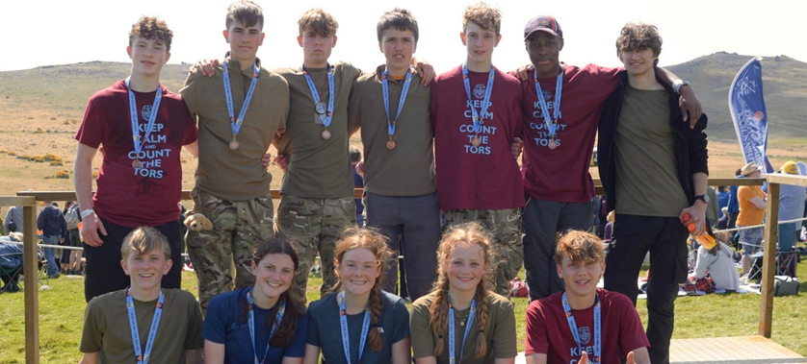
TRAINING
LT col Tim Gilbert– so1 ten tors
MR ANDY HODGES - Head Environmental Compliance monitor

Slide 3
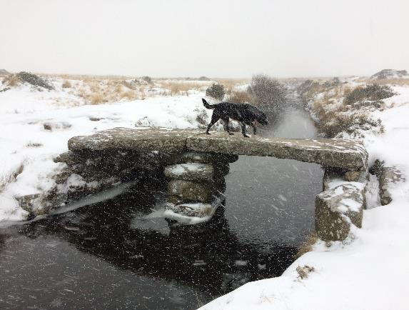
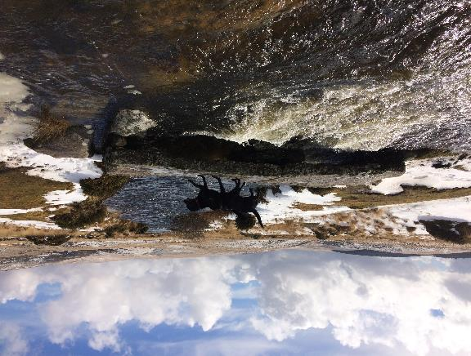
training
scopE
Overview
Training on Dartmoor
Environmental Compliance Monitoring

Slide 4
training
Rules - HOE RESPONSIBILITIES
2. Head of Establishment (HoE). The HoE … is responsible, on behalf of the employer, for the safety of their participants in training, although this may be delegated to a designated Team Manager (completed online via TM Dashboard).
The HoE must assure the Director Ten Tors that all the team management are competent and suitable for the role to which they are assigned.
By sponsoring an entry the HoE accepts responsibility for all participants’ behaviour in training … this includes individuals who are not members of their own establishment.
HoE Assurance to be completed via the dashboard before you can start training.
Notes:
Check para numbers are correct

Slide 5
training
Rules - TM RESPONSIBILITIES
3. Team Manager. The TM, appointed by the HoE, is responsible for all aspects of their Team’s training.
With the agreement of the HoE, the TM may delegate training and other duties to competent and qualified Training Event Leaders, deputies and assistants.
Prior to the start of a Challenge, the TM is required to assure the Director that all participants … are sufficiently trained [and] physically prepared… to complete [their Challenge] unaided even in adverse conditions.
Notes:
Check para numbers are correct

Slide 6
training
Rules - OVERVIEW
22. [General] Requirement. The Challenges are demanding expeditions. Thorough preparation and training are essential to complete the Challenges safely. The HoE is responsible, through their TM, for the conduct of training. The MOD accepts no responsibility for safety in training.
24. Incidents. The Ten Tors Secretary, or at weekends the Ten Tors Duty Officer, is to be informed within 48 hours of any incident in training that:
a. Involves the emergency services.
b. Results in hospital treatment.
c. May result in media coverage.
d. May lead to complaint from a 3rd party.
Notes:
Check para numbers are correct. Check content is updated.

Slide 7
training
Rules – TTC
16. Individual training requirement. Before the Event participants must complete a structured and progressive programme of training which includes as a minimum:
a. 4 days of training on Dartmoor.
b. 2 nights of wild camping on Dartmoor.
c. Experience of walking in an unsupervised group.
17. Team training requirement. In addition to the above, Teams must:
a. Be sufficiently trained, physically prepared and suitably equipped to enable the team to operate safely on their own and complete the Challenge unaided even in adverse conditions.
b. Train as a team on at least one expedition noting that best practice would be to conduct regular training as a defined team. Last minute composite teams are not permitted.
Notes:
Check para numbers are correct. Check content is updated.

Slide 8
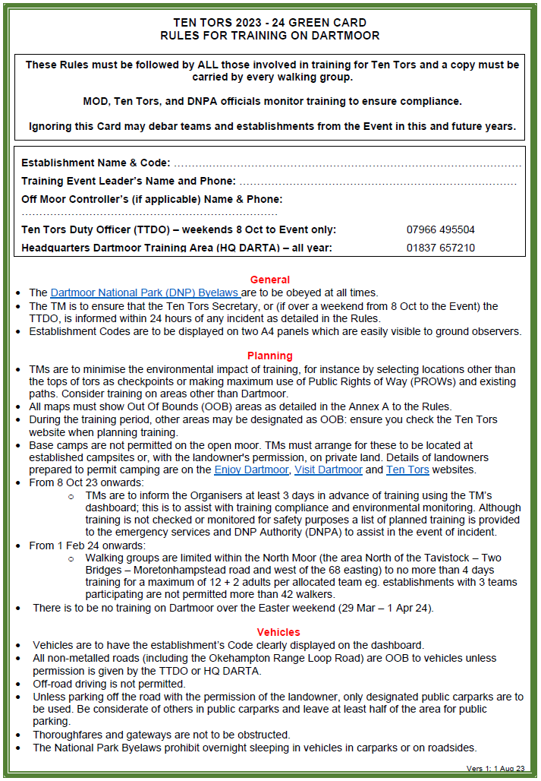
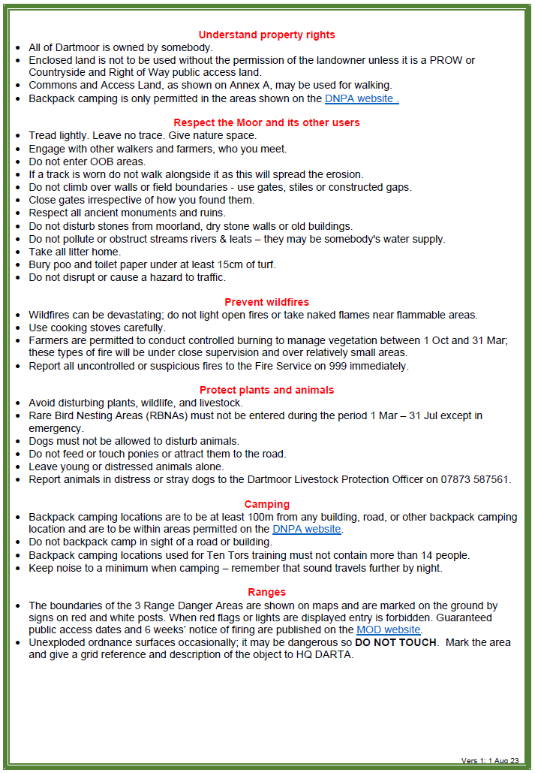
training
Rules – green card
COMPLETE DETAILS

Slide 9
ECM COMPLIANCE MONITORING
ANDY HODGES

Slide 10
ECM
Why do we have Environmental compliance monitors?
100

Slide 11
ECM
What should a meeting with an ECM be like?
An ECM should approach and identify themselves
ECMs are likely to ask where the group has been and where it’s heading.
Ask to see maps with RBNAs correctly marked on them.
Ask about Green Cards: are contents known?
Check that the group is properly identified with Establishment numbers on two rucksacks.
Green card is completed correctly and that the team know their emergency procedures.

Slide 12
ECM
2023 Training Phase data
26 ECMs covered 13 weekends from Jan to April
We spent a total of 137 days out, up from 105
An average ECM day is 7-9 hours, most are part of an establishment’s training team
We met a total of 352 groups, up from 299
301 groups were compliant, 86%

Slide 13
ECM
Non-compliance – how not to fail!
The following issues were the most prevalent:
Green Card (Rules) knowledge was poor;
Groups not carrying Green Cards;
Teams not showing Estb ID numbers;
Gates being reported to be left open;
RBNAs not marked on maps;
Hi vis not being visible!
Campsite etiquette
Same problems as last year – why is that?

