Slide 1
ADMINISTRATION
CAPT RACH ROBB – so3 Ten TORS

Slide 2
ADMINISTRATION
TT Secretary POINTS
Ten Tors Website – primary means of communication
(From registration to event start – changes: TMs, email addresses, new estb/reserve)
Email reminder to check website for key information
Emails:
Check website notices and the rules prior to email
Multiuser – please be patient
Brief participants/parents to check with TM before emailing
Subject line - 1234 Oke Scouts - Payment Issue

Slide 3
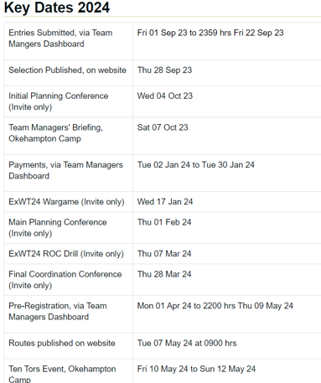
ADMINISTRATION
KEY DATES
All Key Dates (Incl Planning Conferences)

Slide 4
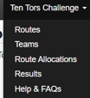
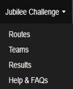
administration
Challenge routes

Slide 5
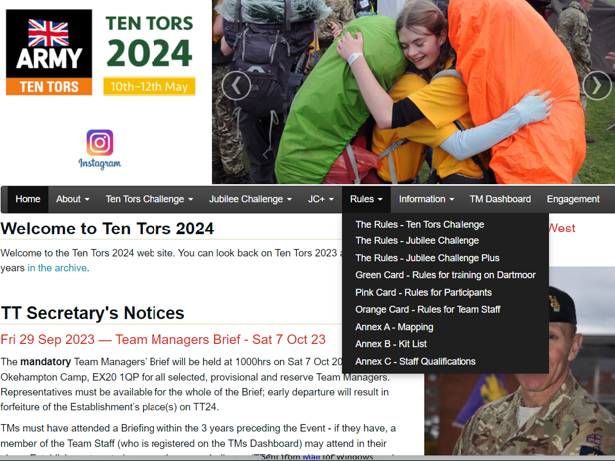
ADMINISTRATION
Event rules
Cards may be marked DRAFT – updated 30 days before event
Annex B - Kit List
Annex C – Staff Qualifications

Slide 6
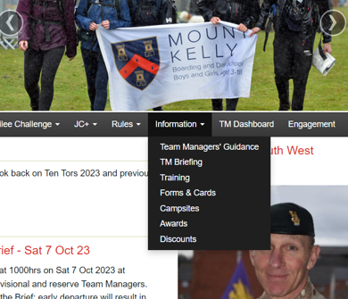
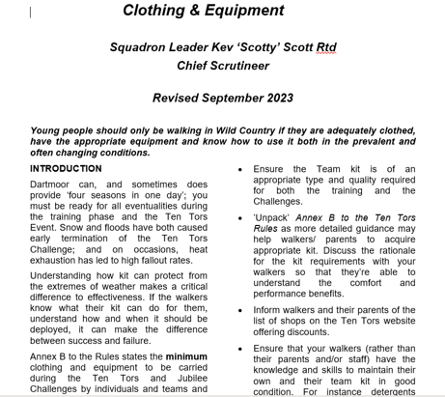
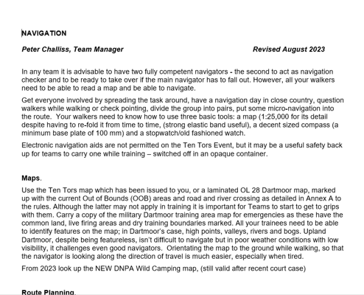
administration
Team MANAGERS' GUIDANCE

Slide 7
administration
TEN TORS TRAINING
Ten Tors training period starts the week after the TM’s Briefing.
Encourage Estabs to organise longer progressive training.
TMs required to inform the Organisers using the TM’s dashboard.
At least 3 days in advance, not indoor training nor activities on sports fields etc.
This is to assist with training compliance and environmental monitoring.
Training is not checked or monitored for safety purposes:
list of planned training walks on Dartmoor is provided to the emergency services & Dartmoor National Park Authority to assist in the event of incident.
Walking groups limited between 1 Feb and the Event. No more than 4 days training within Dartmoor’s North Moor (the area North of the Tavistock – Two Bridges – Moretonhampstead road and west of the 68 easting).
No limitation within Dartmoor's South Moor (training areas outside of Dartmoor is encouraged) .

Slide 8
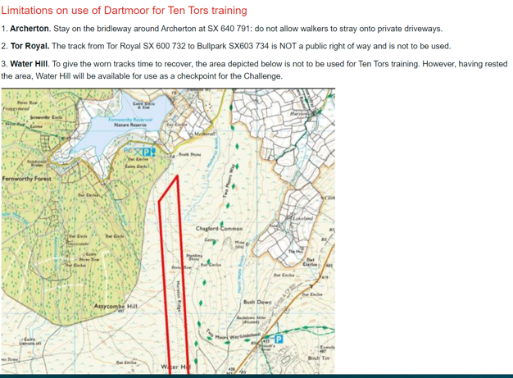
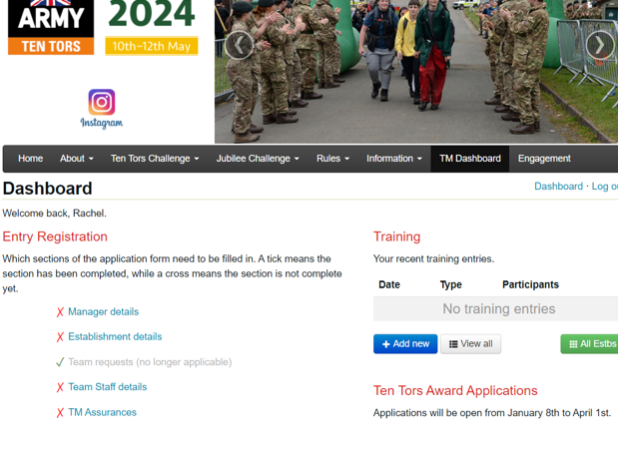
administration
INFORMATION
Training – check before all training for safety updates, OOB areas, carparks closed and more
Campsites and Discounts – we don’t endorse any.

Slide 9
ADMINISTRATION
AWARDS
The Ten Tors Awards are given to those that have made a ‘significant contribution to Ten Tors’ over a qualifying period of time.
The award may be given to TMs, Group Leaders, Volunteer Supporters or military and civilian enablers.
The HoE decides within establishment.
Qualifying period:
• Bronze – 10 years
• Silver – 15 years
• Gold – 20 years
• Diamond – 30 years
• Platinum – 40 Years
• Tungsten - 50 years
The Ten Tors Tri-Award - Nominations for the Tri-Award may be made by anyone. Nominations should be discussed with a member of the Ten Tors organising team, email: SWHQ-TenTors-MAILBOX@mod.gov.uk

Slide 10
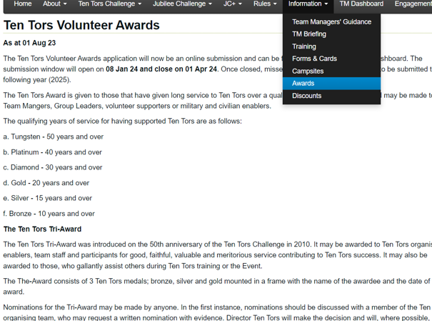
ADMINISTRATION
AWARDS
Award submission open 8 Jan 24 & close 1 Apr 24 (role to next year if missed)
Check awards section (names in red)
Check name spelling
Presentations - collection, unable to post

