Slide 1
THE EVENT
MAJ RUTH GILBERT SO2 TEN TORS

Slide 2
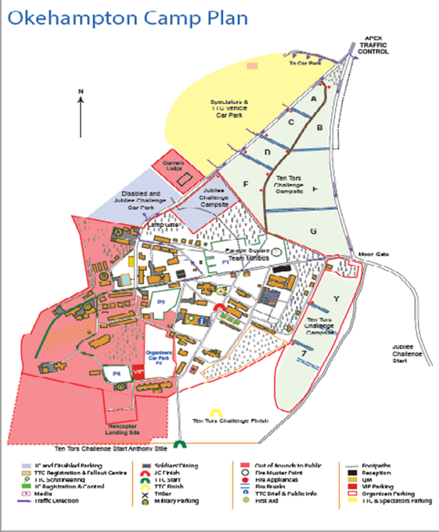
THE EVENT
camp plan
Car park
Parade Square
Campsites
Registration (Sgts Mess)
JC Start
JC Finish
TTC
Start & Finish

Slide 3

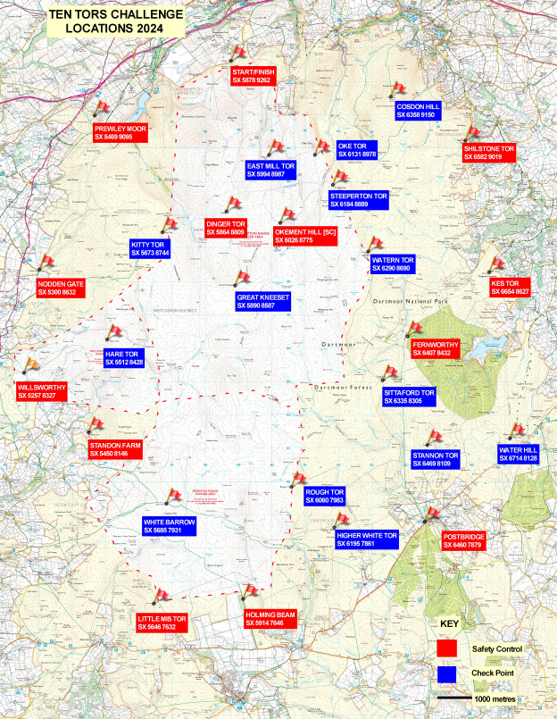
  TTC teams must start with 6 members.
  Age restrictions must be adhered to.
13 Safety Controls
13 support staff
Near road
First Aid posts co-located
All JC locations are SCs
14 Check Points
4 support staff
No fall outs at a CP
Some changes to minimise the need to cross roads

Slide 4

Ten Tors 2024 Orange Card Rules for Team Staff
Ignoring these Rules may disqualify your Team or Establishment from this or future Ten Tors.
Final details for the Orange Card will be updated and published by 2 May 2024.
The draft is available on the website.

Slide 5
Ten Tors 2024 Orange Card Rules for Team Staff
Team Managers (TMs) and Staff are responsible for:
• The conduct and wellbeing of participants:
  From arrival at Okehampton Camp until the start of the Challenge.
  From handover at the Finish or fall out system until departure from Okehampton Camp.
• The conduct and safety of all involved with a Team including supporters.
• Ensuring that all those in the campsites, including visitors, are properly briefed. Visitors entering will receive basic safety information in the brochure issued to all drivers in the carparks.
• Issuing the Notice to Parents and Guardians and acting as the link between them and the Organisers.

Slide 6
Ten Tors 2024 Orange Card Rules for Team Staff
Fire.
• Keep all designated routes in campsites clear and make sure that everyone knows where they are.
• Identify walkways to the designated main routes and liaise with neighbours to keep them clear.
• Minimise the number of gas and fuel containers in the campsites; spares are to be kept in the carparks.
• There must be at least 6m between any tent or camper van used for cooking and any other structure.
• Smoking is only allowed in designated areas; open fires (e.g. wood burners and BBQs) are forbidden.
• Establishments are to provide appropriate fire extinguishers.
• Generators are not permitted on the campsites so that emergency announcements can be heard.
• If there is a fire raise the alarm by shouting FIRE, FIRE, FIRE, call 01837 657267 and 999 and muster on the Parade Square. TMs are to report missing persons to a Steward.

Slide 7
Ten Tors 2024 Orange Card Rules for Team Staff
Medical Assistance.
St John Ambulance have mobile medical staff across Okehampton Camp during the Event that can be tasked by calling mobile number: (TBC two weeks from Event date)
First Aid Posts are established across Okehampton Camp.
Vehicles.
Drivers are to follow the directions of Traffic Marshals, use the one-way circuit and comply with the traffic circuit speed limit of 15 mph.
Unloading and loading is only permitted in designated areas; Jubilee Challenge vehicles will only be allowed to enter the campsite in exceptional circumstances.
Vehicles are to be parked in designated parking areas as directed. Vehicles that are illegally parked or causing an obstruction may be towed away or receive a fixed penalty notice from the Police.
There will be NO vehicle exit from Okehampton Camp on Sat 0600-0700hrs. On Sun 1300-1900hrs all traffic leaving Camp will be directed onto the A30 westbound slip road.
Camper vans are only allowed in designated parts of the carpark; caravans are not permitted.
Please inform spectators – first aid and likely traffic situation

Slide 8
Ten Tors 2024 Orange Card Rules for Team Staff
Environmental Protection.
• Use the litter and toilet facilities provided and report any problems immediately.
• Showers are available for adult Team Staff only on Sat 0800 – 1500hrs in Building 91.
• Do not climb over fences or rest kit on them – use the gateways provided.
General safety.
• Teams or advance parties are not permitted to enter the campsites before Thu 0630hrs. Participants are not allowed to sleep within the campsite until 0900hrs on Fri.
• Establishments are to set up their own base within a campsite at Okehampton Camp; water, toilets, recycling and some catering is available, but otherwise Establishments must be self-sufficient. Please be considerate of others when choosing where to camp.
• Dogs must be kept on a lead, may only transit the campsite, and must not stay overnight in carparks.
• Flying drones is strictly forbidden due to the serious safety risks they pose to helicopters. Please tell spectators.
• TMs are to ensure that alcohol is consumed in a responsible manner; one member of staff must be able to take Safeguarding responsibility for their team at any point. Use What 3 Words for location within campsite.
• Keep campsite noise to a minimum from Fri 2200 – Sat 0500hrs and Sat 2200 – Sun 0700hrs.

Slide 9

Ten Tors 2024 Orange Card Rules for Team Staff
Registration.
• Route allocation will be published on the TT website at 0900hrs on the Tue pre the Event.
• TMs are to report to Registration on Fri 0900 – 1645hrs to:
o Confirm that team composition and critical information is correctly recorded.
o Complete and hand in the Campsite record (use of What 3 Words for TT24).
o Media consent forms (online via the dashboard for TT24).
o Collect the wristband holders, x2 rubbish bags, Tracker, opaque bag for mobile phone and a TT Map (if required).
o Add the river state to Control Cards.
Post Registration.
• Individuals are to be securely fitted with their personal ID wrist bands.
• TMs are to check maps are marked with all staffed locations supporting the JC, JC+ or TTC and all the detail contained in Annex A and Annex B to the Rules.
• TMs are to check teams’ proposed routes for suitability and compliance with the Rules. TMs are to report any late changes to team membership at
Registration on Sat 0530 – 0630hrs.

Slide 10
Ten Tors 2024 Orange Card Rules for Team Staff
Safeguarding.
The TM or Deputy TM member with photo ID, is to accompany participants to their start point by 0645 / 0715hrs.
Either the TM or Deputy TM is to be contactable in Okehampton Camp and able to accept safeguarding responsibility at all times during the Event until all participants have been signed back.
Participants (whether fall outs, crash outs, casualties or successful finishers) will only be signed back to the TM or Deputy TM with appropriate photo ID. In the event of hospitalisation responsibility will be handed over to the hospital and the TM or Deputy TM will be informed.
If a participant has not been returned to the TM by Sat 1800 (JC) / Sun 1700hrs (TTC/JC+) they must report this to the Fall Out Centre to ascertain their location.
Conduct.
Supporters and Staff must not interfere with the smooth running of the Challenge or compromise the unsupported aspect except within 500m of the start and finish where they may encourage and enthuse.
Post event.
TMs are to inform the Organisers of any incident that occurs as
a result of Ten Tors as detailed in the Rules.

Slide 11
Ten Tors 2024 Orange Card Rules for Team Staff
Additional Rules for the Ten Tors Challenge.
Extraction Contingency.
To support contingency plans for extracting large numbers of participants off the moor from Sat 0700hrs until the Establishment’s final departure from Okehampton Camp, any Establishment with more than one team in the TTC is required to:
Designate a road legal minibus which is to:
  Be insured to transport participants from any Establishment.
  Remain parked as directed in Okehampton Camp.
• Ensure a qualified and DBS-checked adult is fit and available to drive at one hour’s notice.
• Plan for both to be deployed across Dartmoor in support of the Event at the cost of the Establishment.
TMs Update. The Team Managers’ Update on Sat 1800hrs will include critical safety information for the following day and thus attendance from at least one member of Staff per Team is mandatory.

Slide 12
Ten Tors 2024 PINK Card Rules for PARTICIPANTS
These Rules must be carried by the Team / Walking Leader and Deputy and followed by all participants.
Ignoring them may disqualify your Team or Establishment from this or future Ten Tors.
Final details for the Pink Card will be updated and published by 2 May 2024.
The draft is available on the website.

Slide 13
Ten Tors 2024 PINK Card Rules for PARTICIPANTS
Includes:
Emergency procedures
If you are lost:
If you have a casualty
Moorland hazards:
Water crossings.
Unexploded Ordnance.
Adders.
Ticks.
Thunderstorms.

Slide 14
Ten Tors 2024 PINK Card Rules for PARTICIPANTS
Cold Injury (Hypothermia).
• Extreme cold, violent shivering, stiffness, tiredness, increased heart rate and irrational behaviour.
• Stop, get under cover, replace wet clothing, rewarm slowly, add extra layers, give warm sweet drink or energy food; do not try to warm by rubbing limbs.
Non-freezing cold injury.
• Hands and feet suffer pins and needles and / or feel numb.
• Dry hands and feet, change socks and gloves, use foot powder, wriggle limbs and exercise.
Freezing cold injury.
• Cold, painful, tingling followed by numbness (including if moved) and mottled white and pink skin.
• Get into shelter; do not re-warm.
Heat illness (Hyperthermia).
• Nausea, vomiting, cramps, disturbed vision, agitation, dizziness and confusion.
• Stop, lie casualty in the shade, remove appropriate layers of clothing, and apply wet cloth to limbs and head. If conscious give water and elevate feet; if unconscious place in the recovery position.
In all cases of climatic injury request assistance immediately and be aware that others are also likely to be at risk.
N.B. Water self-replenishment and purification is the team’s responsibility.

Slide 15
THE EVENT
River CROSSING / ROAD CROSSING / OOBs AREAS
Annex A (as per issued mapping).
OOB Rivers & Roads are for the Event ONLY. However, in trg, all TM’s to make sure participants are aware of the crossings state systems.
Monitoring the routes walked by the Ten Tors Challenge teams helps the Organisers to check on safety and environmental compliance; eg monitor river crossings, teams risking road traffic collisions (by walking on unauthorised public roads), entry into Rare Bird Nesting Areas (RBNA), trespass on non-access land.
Out Of Bounds Areas:
Metalled roads and an area 200m either side unless designated as in bounds.
Rivers (as per the River State) and Out Of Bounds Areas as shown on Annex A to the Rules – ROUTES/CROSSING POINTS MUST BE ADHERED TO - DISTANCES ARE CALCULATED BASED ON THIS.

Slide 16
THE EVENT
RIVER STATES EXPLAINED
THE RIVER STATE TELLS YOU WHICH
RIVER STRETCHES ARE CLOSED AND
WHICH CROSSINGS ARE OPEN
BLACK
RED
AMBER

Slide 17
Post-event
CAPT RACH ROBB – so3 Ten TORS

Slide 18
Post Event
Tt Secretary POINTS
Post Event:
Survey – gives valuable feedback access via TM Dashboard & brochure
Certificates – team & individual (check name spelling)
Email correspondence stops – check website Key Dates
Infringements – not a witch hunt
Pick up Map - TTC 2 x team, JC & JC+ 2 x estab

Slide 19
ENGAGEMENT
MAJ RUTH GILBERT

Slide 20
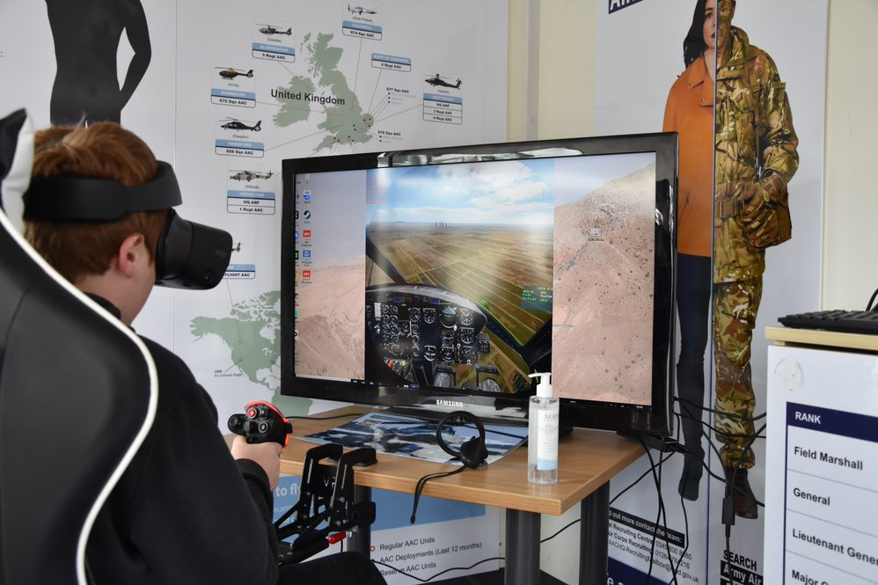
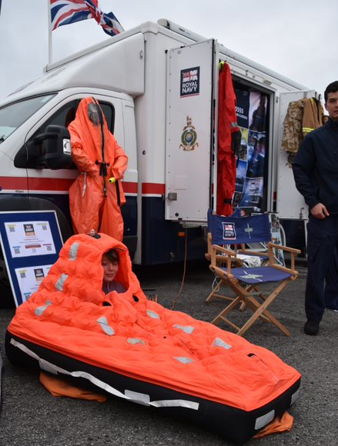





THE EVENT
Engt VILLAGE
Returning next year for the Friday, Saturday and Sunday.
Revised opening hours: Opening earlier on Friday – now from 1030hrs. Open as usual on Saturday and Sunday.
No Fringe on Fri evening, but intend additional PDT jumps on Fri and Sun.
Civilian Agencies welcome to apply for a pitch:
swhq-engagement-mailbox@mod.gov.uk (subject to availability).
Notes:
Hello everyone.
It is good to see you again and we in the Engt branch are busy preparing for another exciting village for Ten Tors 2023.
Last year the village had superb attendance by youngsters and parents alike and we really hope they came away with a better understanding of what the Armed Forces deliver on behalf of the nation.
For next year we are looking to improve again. We are opening earlier on Friday and looking to include the RAF Engt teams and hopefully Defence Science and Technology (DSTL) engt team.
Whilst space in the village is finite we are happy to incorporate other awareness stands e.g. police, Dartmoor rescue, MET office into the village.

Slide 21

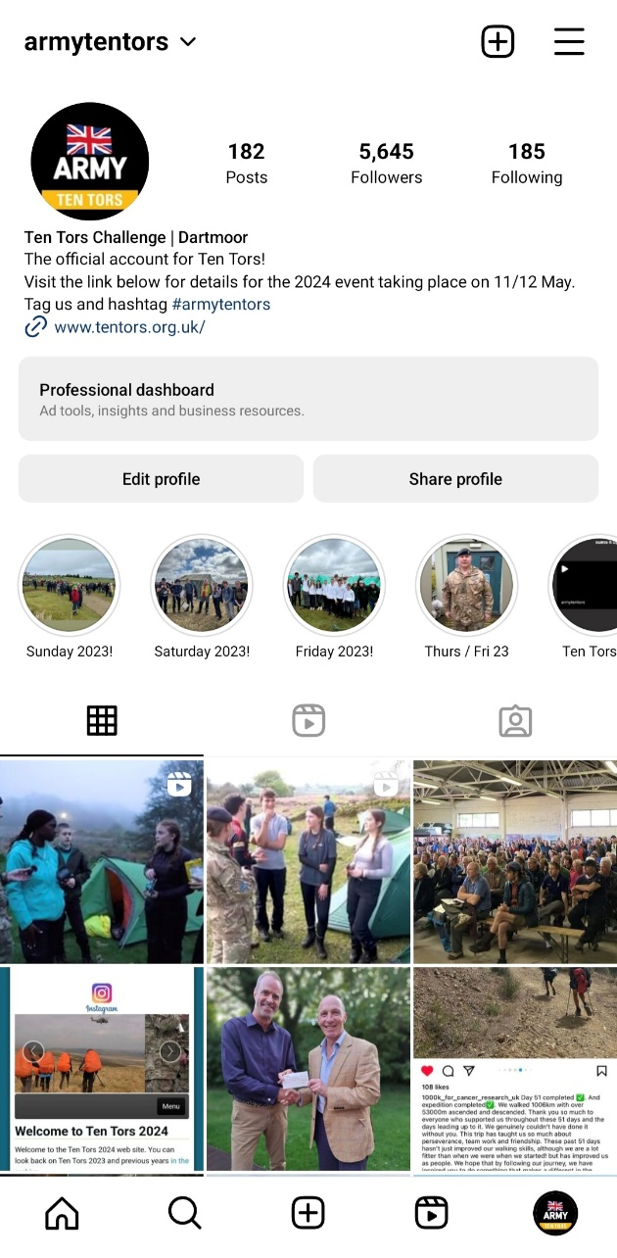
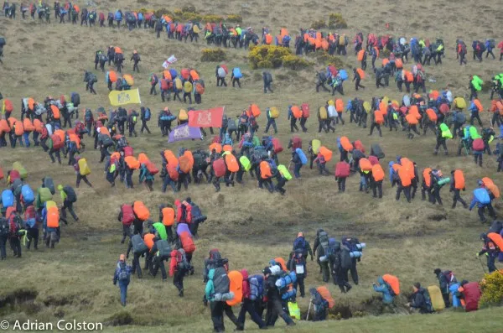
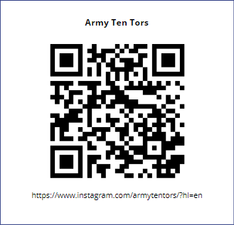
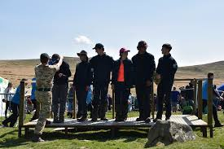
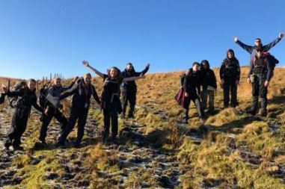
THE EVENT
SOCIAL MEDIA
Please share your stories: @armytentors

Slide 22
SAFEGUARDING
LT COL COLIN GORDON
DESIGNATED SAFEGUARDING LEAD
POLICY
Safeguarding is Everyone’s Responsibility
Policy – available on the TT website, please read and implement
Roles – mutually supporting to ensure the well-being of participants
TMs train, prepare, deploy, support
Military event infrastructure, personnel, safety cover, co-ordination and administration
Responsibilities – shared to protect participants and ensure a safe event
Reputations – good practice, policies, procedures protects reputations

Slide 23

SAFEGUARDING
POLICY
Safeguarding is Everyone’s Responsibility
The Safeguarding timeline – who’s responsible when:
Communication – two way, reports received to DSL on site in Ops Room. Request for support to TMs when necessary.
Partnership – working together at times of crisis, must maintain highest standards at all times.

