Slide 1
INTRODUCTION TO TEN TORS
Crispin d'Apice – so1 ten tors

Slide 2
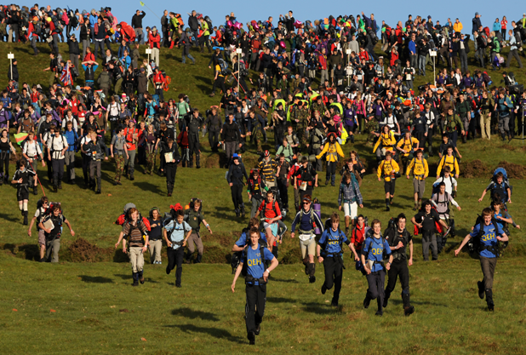
INTRODUCTION TO TEN TORS
PROGRAMME
Preliminaries
Meeting programme
Packs
Ten Tors overview
Questions

Slide 3
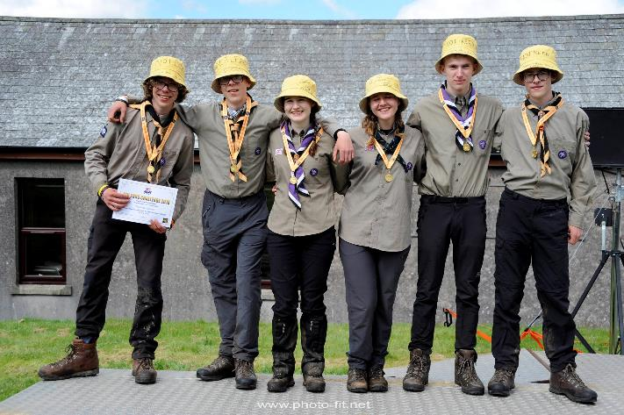
INTRODUCTION TO TEN TORS
Preliminaries

Slide 4
INTRODUCTION TO TEN TORS
PrOGRAMME AM
Time | Category | Subject | Location | Presenter | Remarks
0900 | Introduction | Reception and booking in | Hanger E |  | Collect document packs.
0940 |  | Welcome and introduction to TT |  | Lt Col Crispin d'Apice
0950 |  | Introduction to the DNPA |  | Mr Rob Steemson
1000 |  | Rules |  | Lt Col Crispin d'Apice | New format and overview
1010 | Pre-Event | Eligibility and Administration |  | WO2 Mike Carron | LL, Payment, Pre-Registration
1020 |  | Mountain Training UK - an introduction |  | Mr Andy Barclay Mr Mark Garland
1035 |  | The DRG and safety on Dartmoor |  | Mr Martin Thornton Police representative | LL, overview etc.
1050 |  | Where's to? |  | Lt Col Tony Clark OBE Mr Julian Thorne
1100 |  | Coffee
1130 |  | Training |  | Lt Col Crispin d'Apice Mr Andy Waters | LL, requirements, responsibilities, considerations, Green Card, Environmental Compliance Monitoring
1200 | The Event | Event overview |  | Maj Dave Pickering | Enabling assets, outline etc.
1210 |  | The Team Manager |  |  | LL, Orange Card
1225 |  | The Team |  |  | LL, Pink Card
1240 |  | Clothing & Equipment |  | Lt Col Crispin d'Apice Cdr Jerry Bearne RN | LL
1250 |  | Event infringements |  | Mr Mike Ruffles MBE
1300 |  | Lunch | Cookhouse

Slide 5
INTRODUCTION TO TEN TORS
PrOGRAMME PM
Time | Category | Subject | Location | Presenter | Remarks
1300 |  | Lunch | Cookhouse
1400 | Breakout 1 | Dartmoor Commoners | Hanger E & W, Offrs & Sgts' Messes, TriBar, Wolverson Hall | Mr John Cooper, Mrs Ann Wilcox, Mr Gordon Mortimore, Mrs Karla McKechnie
 |  | TTC Feedback and Q&A |  | Lt Col Crispin d'Apice, Maj Dave Pickering, WO2 Mike Carron, Lt Col Tony Clark OBE, Mr Andy Waters, Mr Mike Ruffles MBE
1430 | Breakout 2 | TTC Feedback and Q&A
 |  | Dartmoor Commoners |  | Mr John Cooper, Mrs Ann Wilcox, Mr Gordon Mortimore, Mrs Karla McKechnie
1400 | Breakout JC | JC-specific arrangements | Offrs’ Mess | Maj Paul McDougall
1500 | Post-event | Infringements and lessons processes | Hanger E | WO2 Mike Carron | LL
1510 | Conclusion | Q&A |  | All speakers
1520 |  | Closing address |  | Lt Col Crispin d'Apice | Main 10 takeaways
1530 |  | Disperse | Hanger E & W |  | Collect mapping and Gift Your Gear

Slide 6
Introduction to ten tors
PACKS
Green Cards
Where’s To
Ten Tors Flyer
3 x Outreach Documents
Questionnaire (not all)

Slide 7
INTRODUCTION TO TEN TORS
TEN TORS OVERVIEW
WHAT
TEN TORS
UK’s largest outdoor youth engagement event
TEN TORS CHALLENGE
Team event
3 Categories – set by age
Saturday 0700 – Sunday 1700
‘Without outside assistance’
JUBILEE CHALLENGE
Individual / Team event
5 Routes – set by Establishment
Saturday 0730 – 1800
Assistance as required

Slide 8
INTRODUCTION TO TEN TORS
TEN TORS OVERVIEW
WHO
2800 participants
2000 Team Staff
1000 enablers
6000 spectators
Plus …
WHERE
Dartmoor Training Area
Duchy and other owners’ land
Dartmoor National Park
Dartmoor Commons
WHEN
Training Oct – May
W/E post-May Day BH
WHY
Training benefit
Social responsibility MOD
Engagement

Slide 9
INTRODUCTION TO TEN TORS
QUESTIONS

