Slide 1
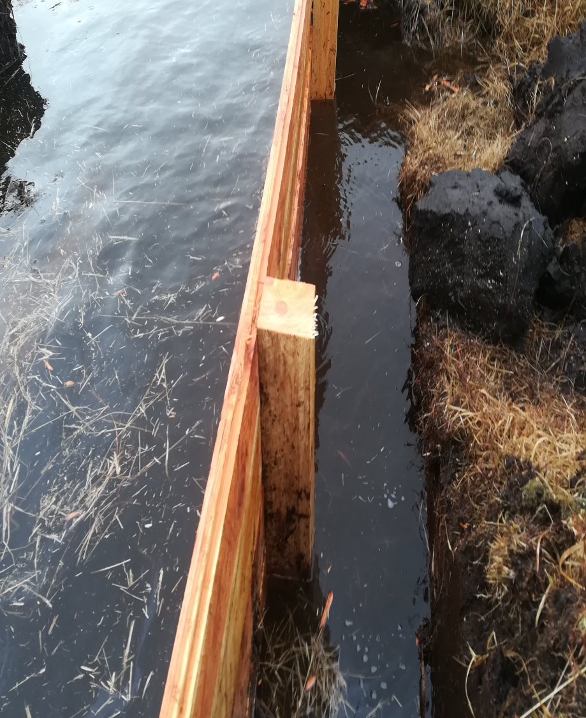
Repair work

Slide 2
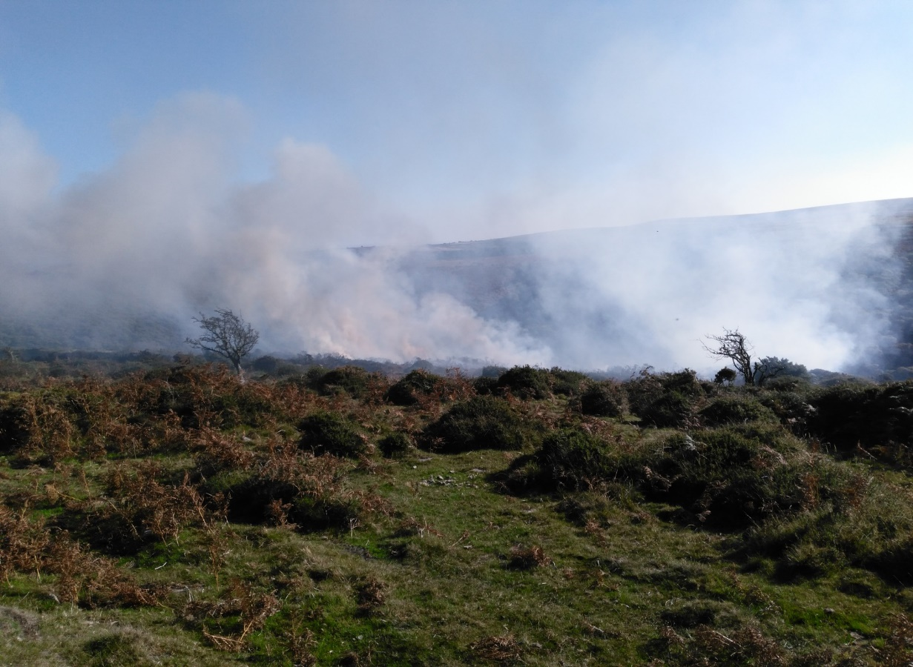
Swaling & wild fires
Commoners (farmers) have always had the right to swale the open commons and access land as part of their ongoing management of Dartmoor. Many Commons and farms are within various agreements with Natural England and burning sites are agreed in advance.
There is also a Dartmoor wide Wild Fire Partnership whereby DNPA, trained Commoners, MOD, Natural England support and assist Devon & Somerset Fire and Rescue Service when a wild fire occurs with personnel and equipment.
Notes:
Dartmoor’s majestic scenery, wide open spaces, habitats and wildlife, cultural heritage – all make up elements of this special, protected landscape

Slide 3
Ranger Service
The Ranger Service providing and maintaining gates, stiles, and bridges for the Public Rights of Way inside the National Park
Notes:
All of the various users of Dartmoor – farmers, military, recreational, forestry, water supply, mineral extraction – have an impact on the fabric of the moor.
The National Park Authority works with these stakeholders to minimise damage and maximise conservation benefit and access – and this sometimes involves undertaking specific work ourselves…

Slide 4
Information and Education

Slide 5
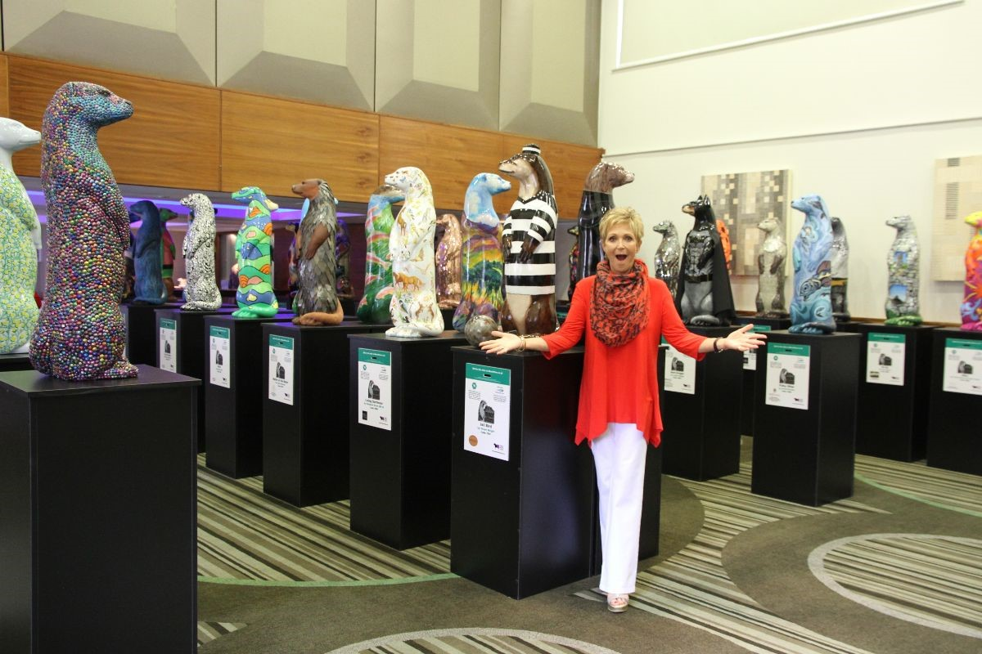
Moor Otters return
Moor Otters are set to return to Dartmoor National Park next summer – and this time, they’ve got company. From May to October in 2020 visitors can expect to see over 80 sculptures, each individually designed and decorated by artists and local talent, dotted across Dartmoor and surrounding areas
In 2017 the scheme raised £60,000 which was split three ways – Junior Ranger Scheme, Invasive non – native plant control and ongoing erosion repair
Notes:
In 2017 the scheme raised £60,000 which was split three ways – Junior Ranger Scheme, Invasive non – native plant control and erosion repair

Slide 6
Postbridge centre & car parks
Postbridge Visitor Centre is about to embark on a new chapter in its history as it undergoes a £500,000 extension. Dartmoor National Park Authority is taking the next steps in its ambitious vision to transform the centre and tell the Dartmoor Bronze Age story in greater detail. The centre has closed its doors for preparation work. Construction will start on 21 October and will last 32 weeks
DNPA is asking regular visitors for views about introducing an annual parking pass and wants to hear from people about whether they would support any introduction of an annual £35 pass which could be used all year round for Dartmoor National Park-owned car parks at Haytor, Postbridge and Meldon Reservoir. Survey is open via website until 25 October.

Slide 7
Livestock Protection Officer
Karla McKechnie
07873 587561

Slide 8
Can you help?
Robert Steemson 07711 856206 rsteemson@dartmoor.gov.uk

Slide 9
Notes:
Dartmoor’s majestic scenery, wide open spaces, habitats and wildlife, cultural heritage – all make up elements of this special, protected landscape

