Slide 1
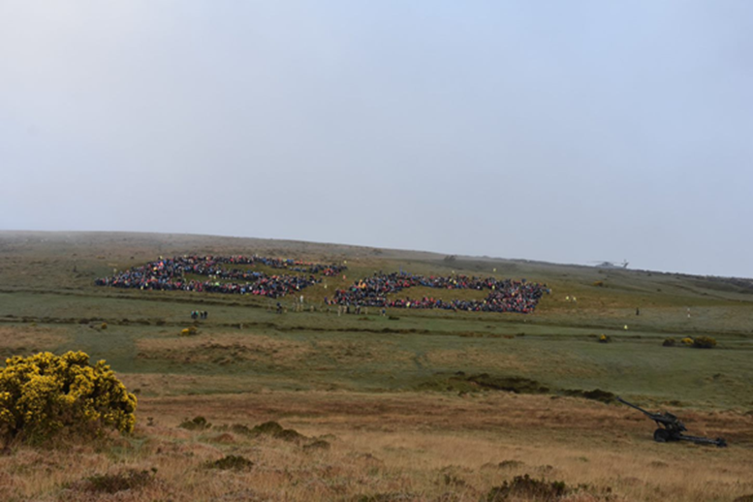
DARTMOOR NATIONAL PARK AUTHORITY
MR SIMON LEE

Slide 2
Ten Tors Team Managers’ Presentation
Simon Lee Head Ranger

Slide 3
Notes:
Dartmoor National Park is one of a ‘family’ of UK National Park Authorities that have been established to protect and enhance on a landscape scale and to provide opportunities for public access, enjoyment and understanding.
Dartmoor was one of the first four UK National Parks – set up in 1951

Slide 4
What makes Dartmoor special?
In terms of its ecological and cultural heritage, Dartmoor is of international importance for its:

Slide 5
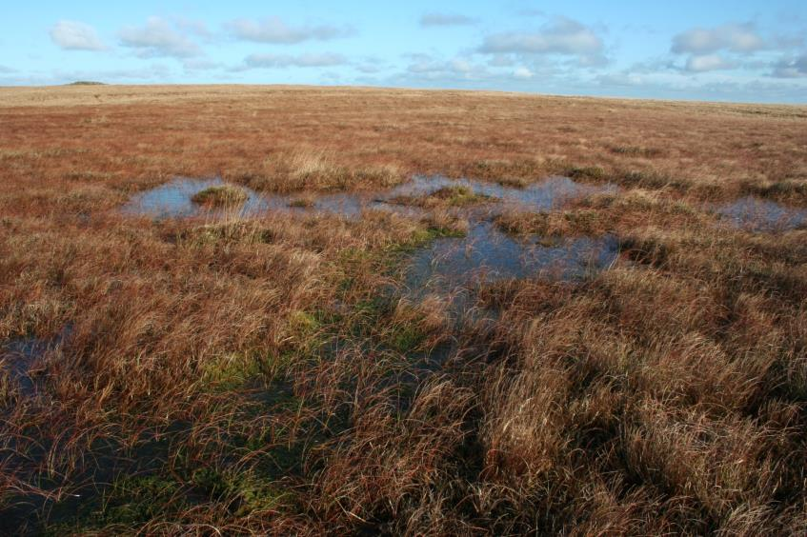
Southernmost blanket bogs in Europe
Notes:
Blanket bog – in addition to being important as a habitat and rich in biodiversity – is responsible for locking up large amounts of carbon. It is estimated that the blanket bog on Dartmoor holds 10 years worth of Devon’s carbon production.
Blanket bog is a thin living skin of mosses – mostly Sphagnum species – over a semi-liquid mass of partly decayed vegetation.
Currently the “Mire’s Project” is restoring old peat cuttings to increase blanket bog on the high moor.

Slide 6
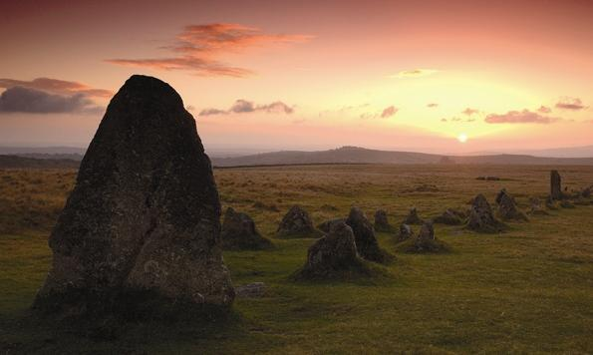
Over 20,000 archaeological sites

Slide 7
Upland Heaths

Slide 8
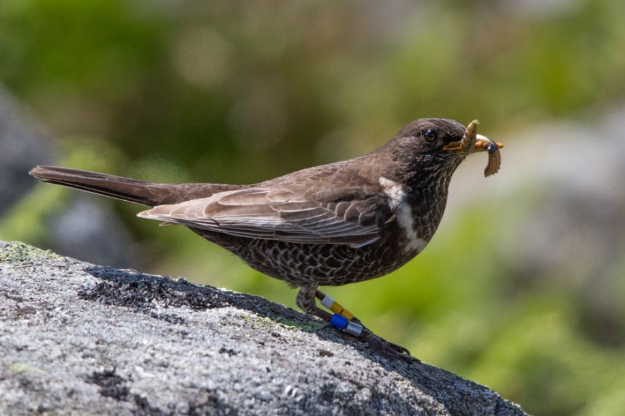
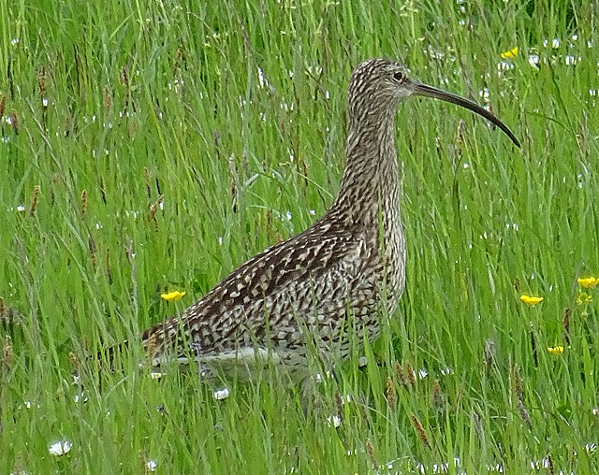
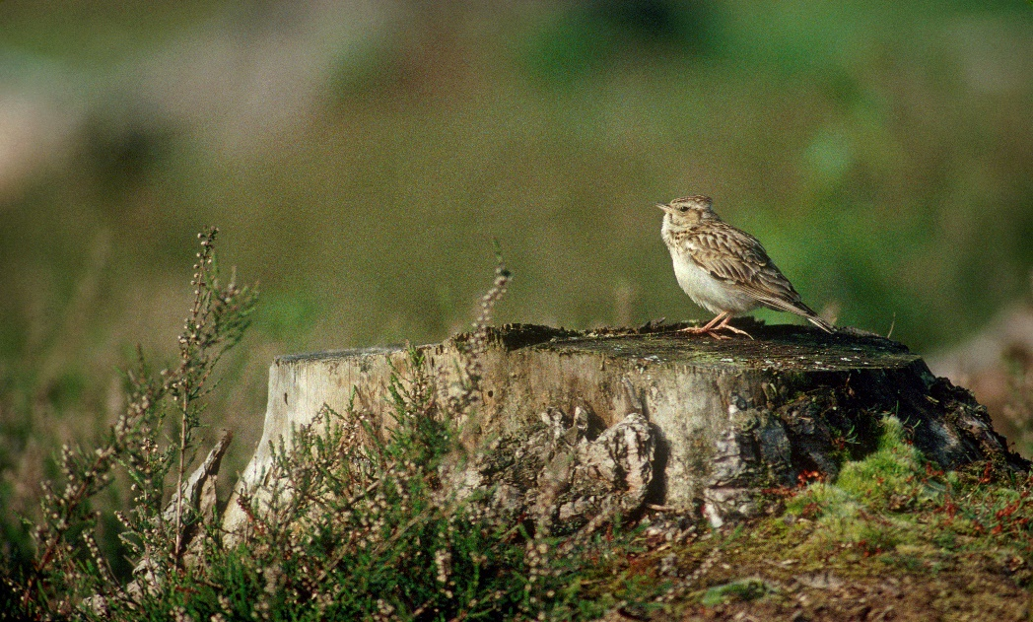
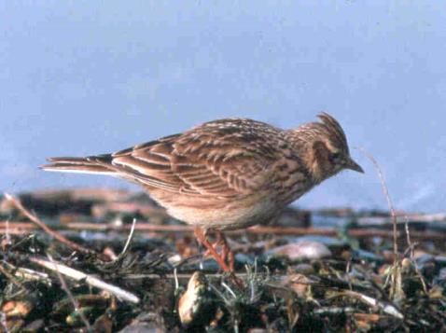
Important for ground nesting birds
© Nick Baker / RSPB
Notes:
Ring ouzel (female) – now restricted to steep valley sides and clitter
Skylark – one of the important ‘ground nesting birds’ common on open grass moor

Slide 9
Upland Oak woodlands

Slide 10
Farming

Slide 11
How can you help us conserve and support this important landscape and its communities.

Slide 12
Love Moor Life – Ranger code
Our Rangers care passionately about Dartmoor; it’s a unique protected landscape with rare wildlife and free roaming livestock and ponies.
Keeps dogs under close control Close & latch gates behind you
Bag up litter and take it home Use a campsite or check the website
Share the roads & bridleways Don`t feed the ponies

Slide 13
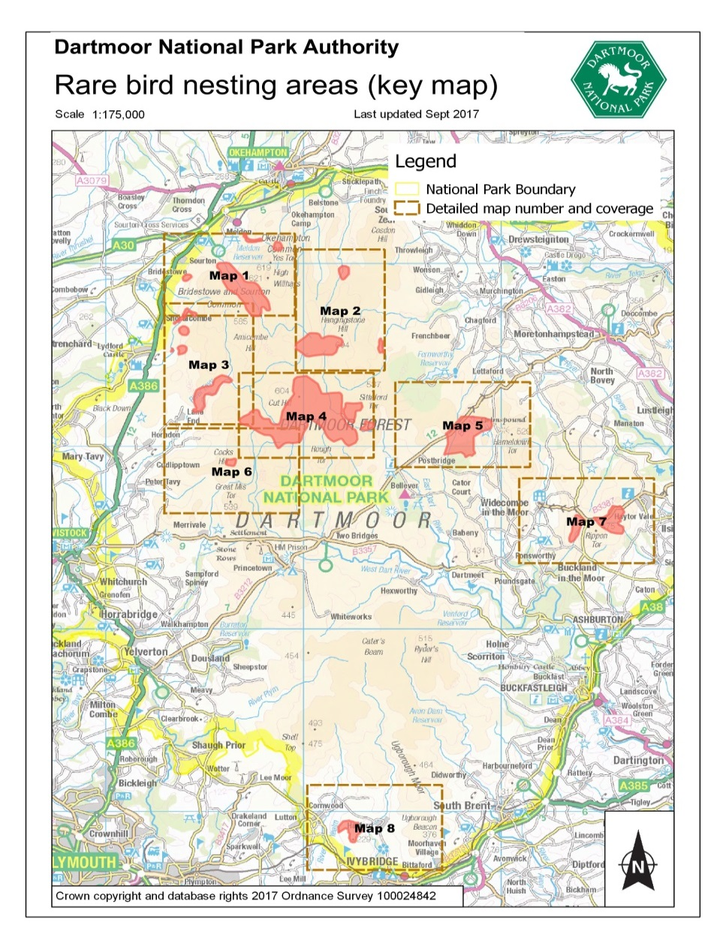
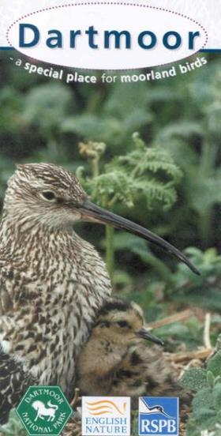
Protecting ground nesting birds

Slide 14
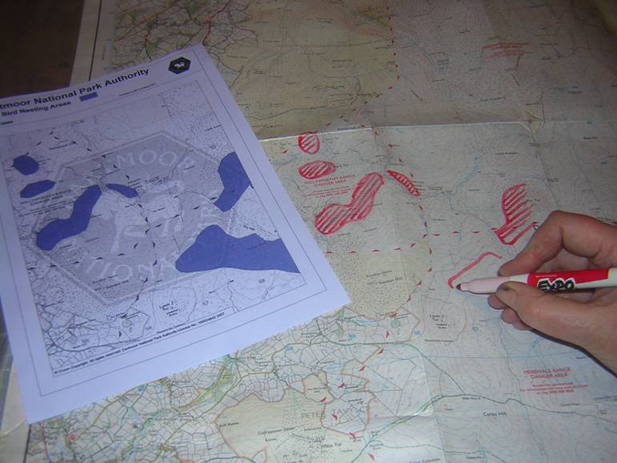
Transferring bird nesting areas onto maps

Slide 15
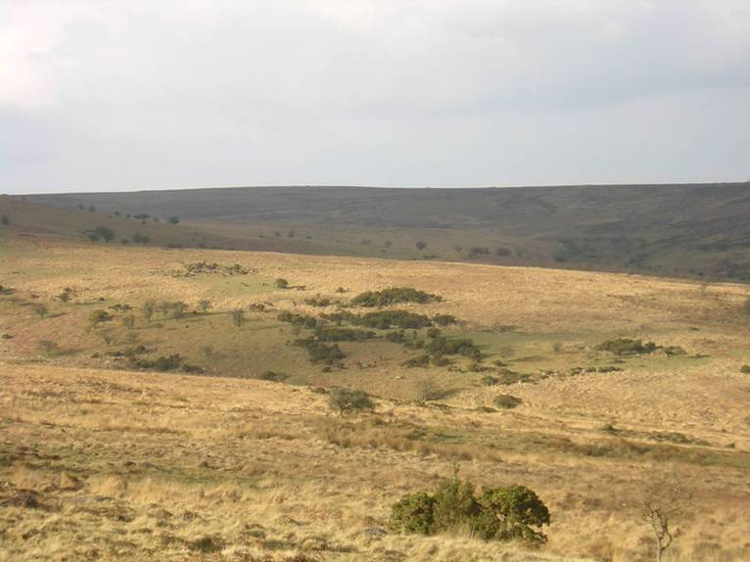
Managing erosion and the temptation of ‘open landscape’

Slide 16
Choosing the easier route

Slide 17
Donate for Dartmoor
The National Park is challenged by Government to bring in more funding. The Donate for Dartmoor scheme is aimed at predominately recreational users.
People can donate their:
Money – to help fund projects
Time – to help with Volunteering tasks
Notes:
Donate for Dartmoor has replaced £ for the Park.
Targetted Event Organisers, so widened this to appeal to the general public.
Event Organisers and event participants are still encouraged to make a donation – these will go to our Recreational Dartmoor fund.
Rebranded as Donate for Dartmoor – now includes donating MONEY and TIME for volunteering.

Slide 18
Donate for Dartmoor
The “Donate for Dartmoor” initiative is a voluntary donation scheme - participants taking part in all organised events are invited to make a £2 donation in addition to their entry fee
The Ten Tors Policy Committee supports this scheme
Donations will be ring-fenced and used for practical access repairs and improvements, as well as to support conservation projects
Notes:
Voluntary Donation to the National Park Authority. The “£ for the Park” initiative is a voluntary donation scheme whereby participants taking part in organised events are invited to make a £1 donation in addition to their entry fee, thus enabling them to put something back into Dartmoor. The Ten Tors Policy Committee supports this scheme and recommends donations of at least £1 per team. Your voluntary contribution will be used to support access and conservation projects in the Dartmoor National Park. Please add any donation you wish to make to your fee. All £ for the Park donations will be passed onto the National Park Authority. Donations will be ring-fenced and used for practical access repairs and improvements, as well as to support conservation projects. If you have suggestions for suitable projects, please inform the Head Ranger, Rob Steemson, at rsteemson@dartmoor.gov.uk .

Slide 19
Standon Bridge

Slide 20
How does it work?

Slide 21
Donate for Dartmoor - help

Slide 22
Notes:
Dartmoor’s majestic scenery, wide open spaces, habitats and wildlife, cultural heritage – all make up elements of this special, protected landscape

