Slide 1


TEN TORS/Ex WYVERN TOR
ENABLERS’ MANDATORY PRE-BRIEF

Slide 2
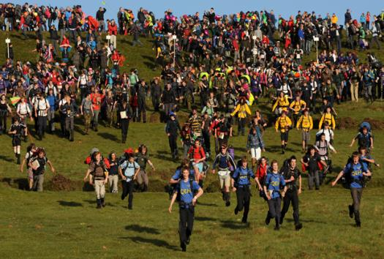
ENABLERS’ MANDATORY PRE-BRIEF
scope
Introduction to Ten Tors (TT)
Orders
Safety
Safeguarding
Engagement
Administration
Notes:
Enablers will be issued the Aide Memoire to Enablers (the Blue Card) on arrival on TT. The Blue Card contains all the information contained in this brief with some additional detail.

Slide 3
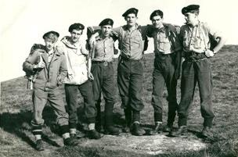
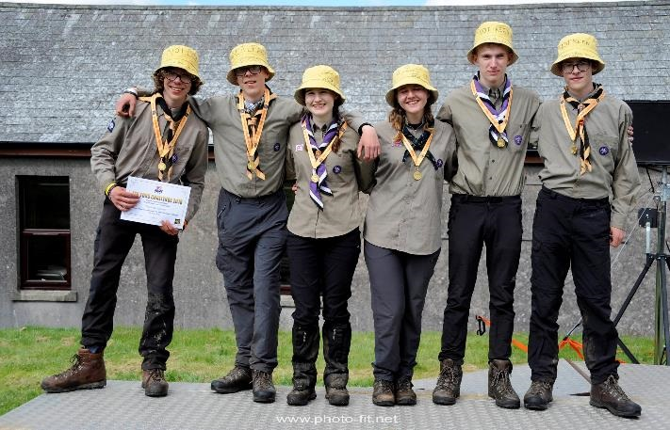
ENABLERS’ MANDATORY PRE-BRIEF
background
Started in 1960 by R SIGNALS Junior Leaders’ Regt.
UK’s largest outdoor youth engagement event.
2025 theme: Volunteering

Slide 4
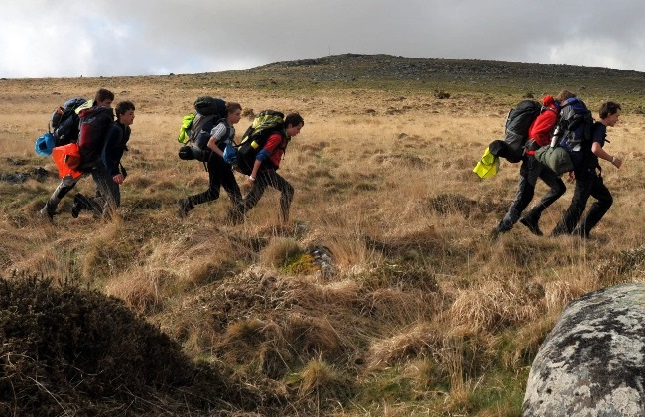
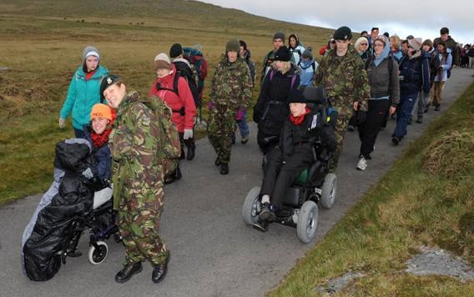
ENABLERS’ MANDATORY PRE-BRIEF
TEN TORS OVERVIEW - what
TEN TORS
Overarching Event, inc TTC, JC and JC+
TEN TORS CHALLENGE
Team event
Self-sufficient
Up to 55 miles
Sat 0700 – Sun 1700
JUBILEE CHALLENGE
Individual / Team event
Assistance as required
Up to 15 miles
Sat 0730 – 1800
JUBILEE CHALLENGE PLUS
First year as full challenge
Assistance as required
Up to 20 miles, inc overnight
Sat 0730 – Sun 1100
Notes:
WHAT IS TEN TORS?
Difference between:
Ten Tors. The overarching Event which consists of everything including 2 x challenges, 1 pilot challenge, OKC management, spectator management, engagement activities, visits.
Ten Tors Challenge. Teams of 6 teenagers are entirely self-sufficient as they walk routes of 35, 45 or 55 miles across Dartmoor over 2 days.
Jubilee Challenge. Open to teams and individuals aged 13 – 21 with physical and neurological challenges. Participants travel up to 15 miles depending on their ability and start and finish on the Saturday.
Jubilee Challenge Plus: First year as a full Challenge after 2 successful pilots. Participants and staff are responsibility of the JC Gp until they cross the Start, at which point they will switch to become responsibility of TT Ops.

Slide 5
ENABLERS’ MANDATORY PRE-BRIEF
TEN TORS OVERVIEW
WHO
2,800 participants
2,000 Team Staff
700 mil enablers
300 civ enablers
6000 spectators
WHEN
Training Oct – Apr
TT Event 9/10/11 May
WHERE
OKC
Dartmoor Training Area
Dartmoor National Park
Notes:
WHO: Numbers shown are conservative but give an idea as to the scale of the event.
WHEN: Although the Event only lasts a weekend, participants will have been training for up to 9 months – do not underestimate how much commitment has been put in simply to get to the Start Line.
WHERE: The Event is run from, and the Challenges start and finish in, OKC. The Challenges take place across Dartmoor Trg Area and National Park. It is 26 km from OKC to the Southernmost staffed location.

Slide 6
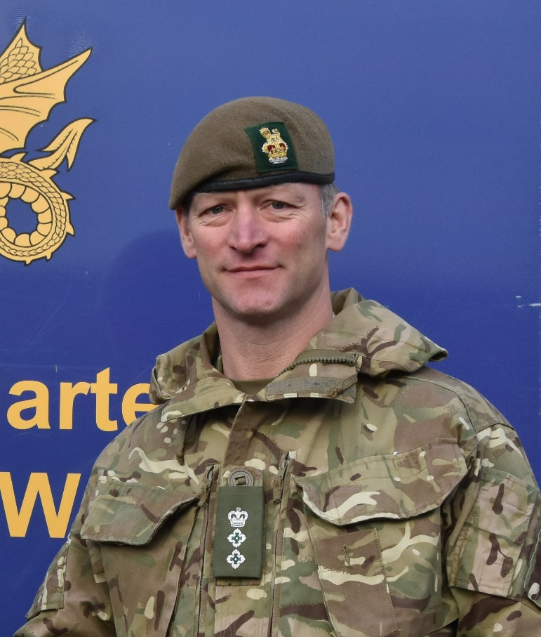
ENABLERS’ MANDATORY PRE-BRIEF
mission
HQ SW is to deliver Ex WYVERN TOR*, maximising engagement opportunities and maintaining consent to train on DNP in order to connect with society and secure Defence’s reputation in the SW.
*Ex WYVERN TOR is the name of the military exercise that supports the Ten Tors Event.

Slide 7
ENABLERS’ MANDATORY PRE-BRIEF
CONCEPT OF OPERATIONS
INTENT: My intent is to run a safe and challenging event, whilst maximising ENGAGEMENT at targeted audiences. I will DEFINE a controllable exercise area, then LAUNCH, MONITOR and RECOVER participants whilst MINIMISING the impact on DNP. Throughout, I will PROTECT Defence’s reputation and MEASURE the effects of my ENGAGEMENT.

Slide 8
ENABLERS’ MANDATORY PRE-BRIEF
CONCEPT OF OPERATIONS
SCHEME OF MANOEUVRE:
Phase 1 - Preparation of OKEHAMPTON CAMP (OKC).
Phase 2 - Deployment.
Phase 3 - Arrival of establishment staff and participants.
Phase 4 -TTC.
Phase 5 – JC/JC+.
Phase 6 - Recovery and dispersal.
MAIN EFFORT: Ensuring the SAFETY of all participants and lies with the Moor Support Group (MSG).

Slide 9
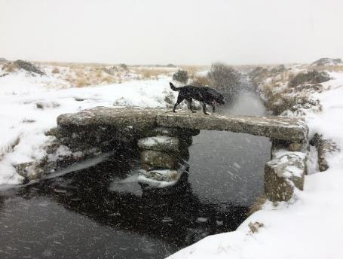
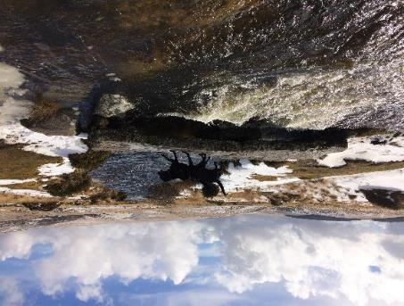
ENABLERS’ MANDATORY PRE-BRIEF
Safety on DARTMOOR
High moorland.
Extremely changeable weather.
Moor OOB unless activity is properly planned and briefed.
Notes:
Photos are of same bridge (and dog) less than 48 hours apart.
Do not go onto the moor unless it is part of an organised activity that has been properly planned and briefed.

Slide 10
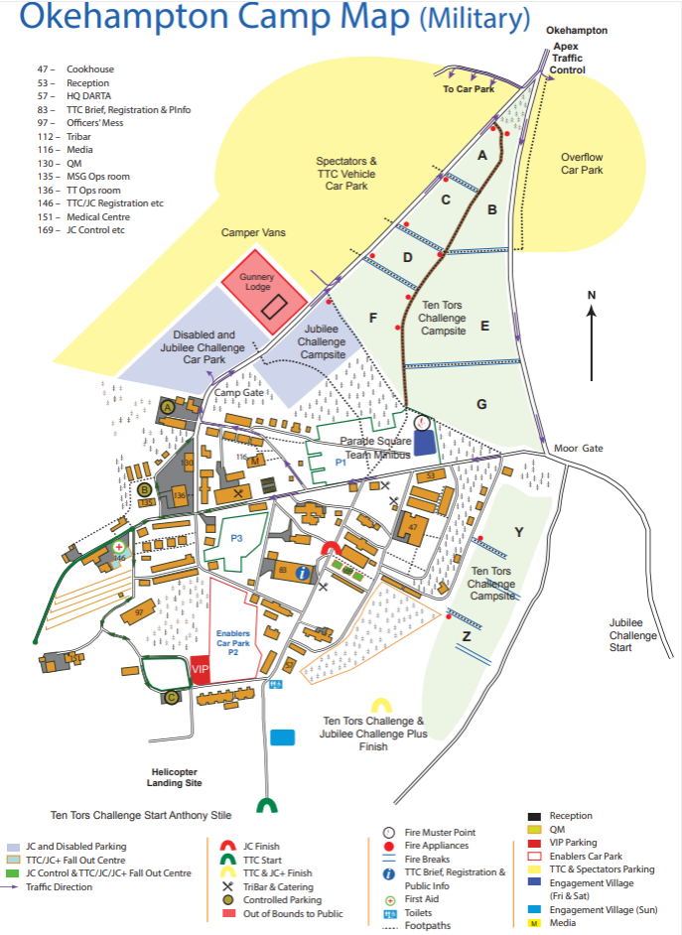
ENABLERS’ MANDATORY PRE-BRIEF
Safety in OKC
Over 5K staying in OKC with additional 6K visiting
Proper crowd control and event management crucial
Follow direction in TT Blue Card
In particular:
  Life-saving First Aid only to participants / public.
  Drive sensibly.
  Familiarise yourself with OKC layout.
  No alcohol from Thu 2359hrs.

Slide 11
ENABLERS’ MANDATORY PRE-BRIEF
safeguarding
Policy.
Responsibilities.
Communication.
Safeguarding Team:
Designated Safeguarding Lead (DSL): Mr Nathan Ditton
Contactable via TT Ops
Notes:
Note this is a Level 1 Safeguarding Brief only – anyone requiring additional briefing will receive it on arrival at TT.

Slide 12
ENABLERS’ MANDATORY PRE-BRIEF
Safeguarding Policy Overview
Available on Ten Tors website: Ten Tors 25 Safeguarding Policy
TT has an excellent record of delivery, this formalises the safeguarding process.
Reinforces already good practise and provides structure for reporting.
Promulgated to all participating units and support organisations.

Slide 13




ENABLERS’ MANDATORY PRE-BRIEF
Chapter 1 – child protection & safeguarding policy
If it doesn’t look right
If it doesn’t sound right
If it doesn’t feel right
Speak to the TT DSL immediately.

Slide 14

ENABLERS’ MANDATORY PRE-BRIEF
Chapter 1 – child protection & safeguarding policy
Child Abuse can be:
Sexual Physical
Emotional Neglect

Slide 15
ENABLERS’ MANDATORY PRE-BRIEF
Chapter 2 – preventing child abuse
Preventing child abuse is every adult’s responsibility.
Participants will and should see adult organisers as people they can trust.
Adults must act if:
  A child discloses any form of abuse;
  You see something that concerns you;
  You are concerned about unsafe practice;
  You are complained about.
TT DSL Team is the immediate source of advice and support, via TT Ops.

Slide 16
ENABLERS’ MANDATORY PRE-BRIEF
Chapter 3 – procedures & good practice
TT is an arduous event with a high likelihood of injury or exhaustion. This potentially makes all participants temporarily vulnerable and increases the need for adults to understand the need for procedures and good practice.
Young people should be encouraged to help and support each other.
Allegations of abuse must be taken seriously.

Slide 17
ENABLERS’ MANDATORY PRE-BRIEF
Chapter 3 – procedures & good practice
Adults should not intervene to help young people put on or remove kit and equipment - let the participants help themselves.
Adults must not operate alone with young people.
If an allegation is made against a member of staff or other adult, contact the DSL Team immediately and follow the guidance provided.
Reporting must be in accordance with Annex A to the TT/ExWT Safeguarding Policy.

Slide 18
ENABLERS’ MANDATORY PRE-BRIEF
Chapter 4 – photography & social media
Official photographers are authorised by HQ SW.
Civilian media will be present.
Enablers (other than media staff) should not take photographs of participants on their own private cameras or smart phones.
Inappropriate photography and storage or distribution of images is prohibited.

Slide 19
ENABLERS’ MANDATORY PRE-BRIEF
Chapter 5 – dos & don’ts
Do follow the direction in the ExWT/TT Blue Card:
Do contact the TT DSL Team via TT Ops if you have a concern.
Don’t involve any more people than necessary when reporting an incident.
Ten Tors Blue Card TT25

Slide 20
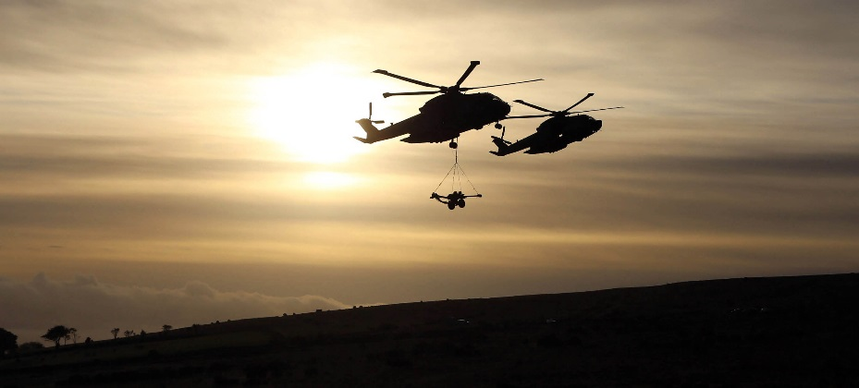
ENABLERS’ MANDATORY PRE-BRIEF
engagement
TT is a key engagement activity.
Do all you can to exploit the many engagement activities and opportunities.
Familiarise yourself with the Key Messages in the ExWT/TT Blue Card.
Don’t engage with the media except through the TT Media Centre.
Notes:
TT is the Army’s biggest engagement event in the SW and it’s biggest youth engagement event in the UK. It is also of huge benefit to other services and organisations, notably in 2019 (due to the YoGA theme) DEFRA, the Dartmoor National Park Authority and others with an environmental focus.
There are numerous engagement events / activities occurring over TT including a parachute display team, band, static displays, outreach teams and visitor events. Organisations conducting engagement as part of their TT activity include all 3 services, the Police, Ambulance Service, Dartmoor Rescue Group, Other Government Departments and others. Get involved with engagement activities and encourage others – particularly members of the public – to do likewise.
More detail is in the Blue Card including Actions on Media.
TT is a key engagement opportunity however that engagement must be done properly and in a coordinated manner – thus the last point.

Slide 21
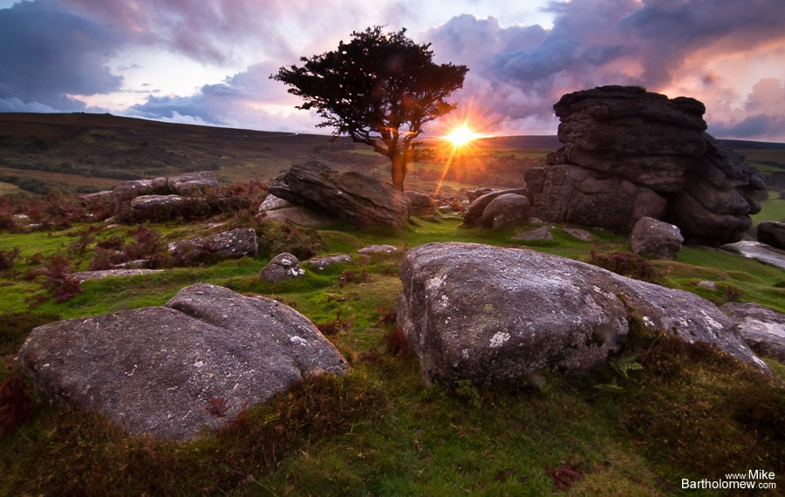
ENABLERS’ MANDATORY PRE-BRIEF
administration
Accommodation is extremely crowded – be considerate.
Vehicles to be parked sensibly.
Bring kit to deploy on Dartmoor if required.
Well behaved and insured dogs on leads are permitted in OKC but not overnight. Please dispose of waste in bins provided.

Slide 22
ENABLERS’ MANDATORY PRE-BRIEF
Thank you
Thank you!
Functional lead to email
SWHQ-TenTors-MAILBOX@mod.gov.uk
with nominal roll and date that this brief was delivered by NLT 2200hrs Thu (D-2)

