Slide 1
National Navigation Award Scheme Ten Tors Team Managers 14 Oct 2017
James Woodhouse

Slide 2

Where do we want to go..

Slide 3
James Woodhouse Technical Advisor
Wellington School and RMA Sandhurst
BSc (UCL) PGCE(OE) (Edinburgh)
Commanded C Coy RRS
Mountain Instructor Certificate, Joint Services Alpine Mountaineering Instructor
Course Director ML(S) training and assessment
NEBOSH General Certificate OHS
NNAS Tutors Course Director and Technical Advisor

Slide 4
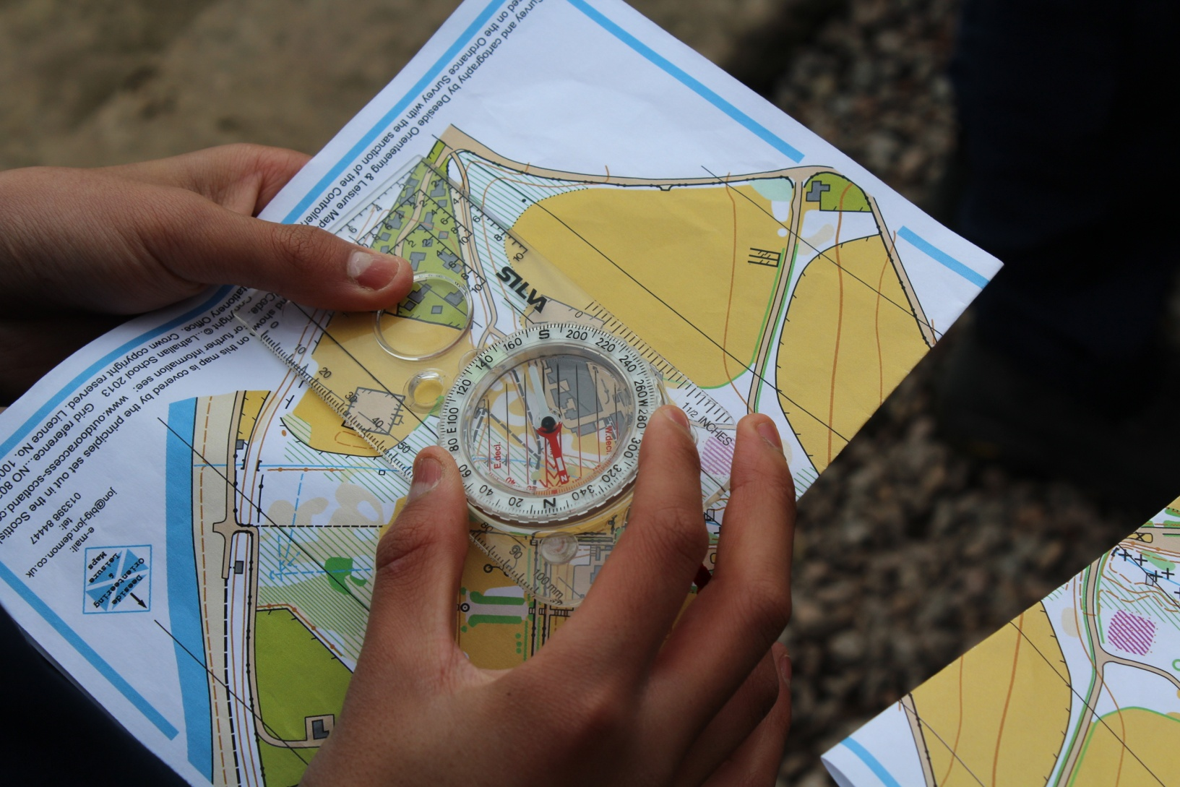

Slide 5
NNAS background
20 years old from British Orienteering
Aimed at land based recreational navigators
Bronze Silver and Gold (ML Summer equivalent)
Outdoor Discovery Award
Step change in approach and methodology within the last two years based on a fundamental belief that children are far more capable than adults remember or understand.

Slide 6
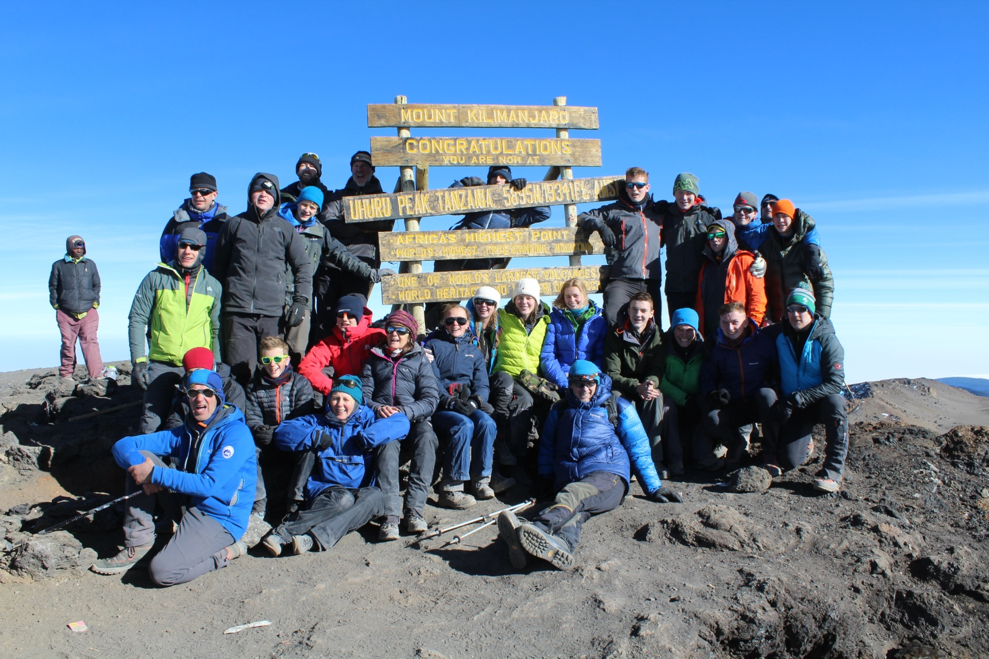
Children (youngest twelve years) and adults (oldest fifty- seven)..

Slide 7
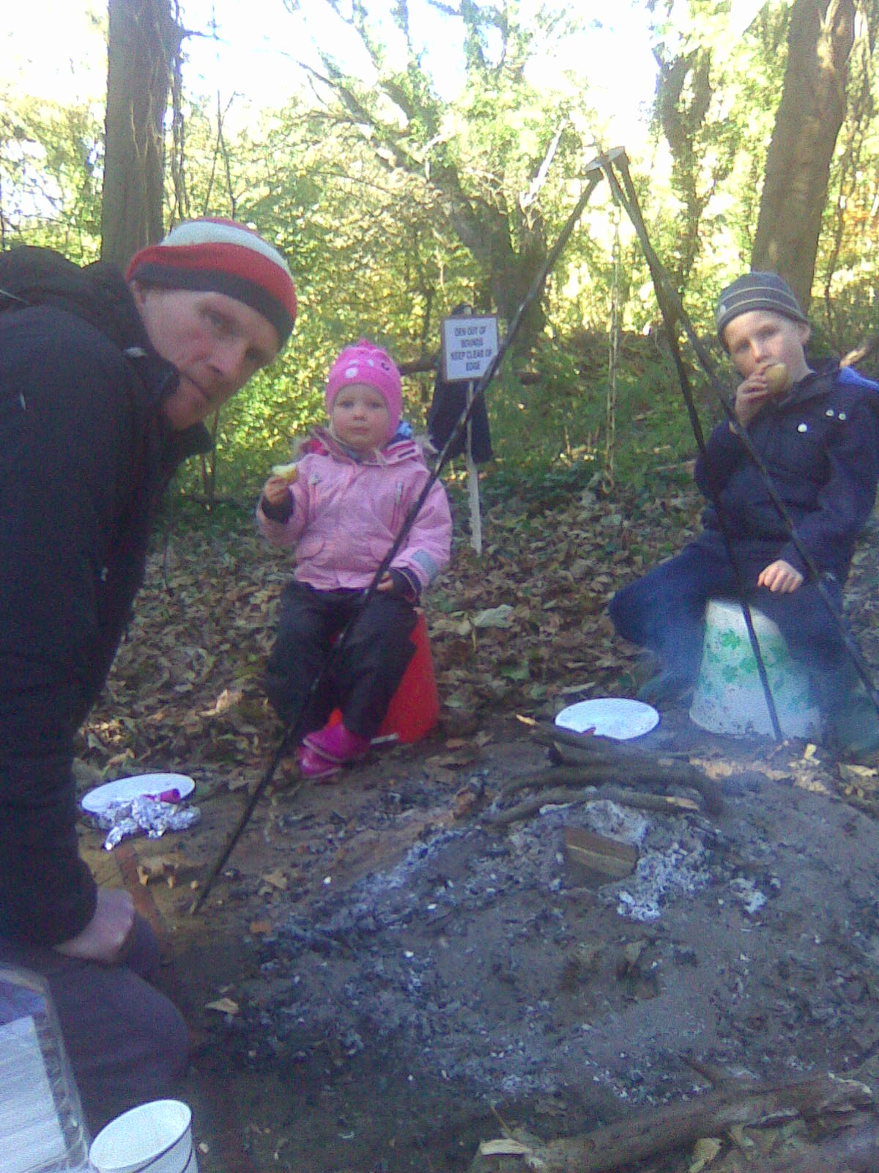
Outdoor Discovery Award Participants

Slide 8
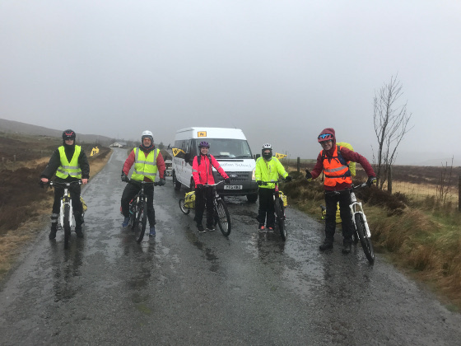
Land based navigation techniques

Slide 9
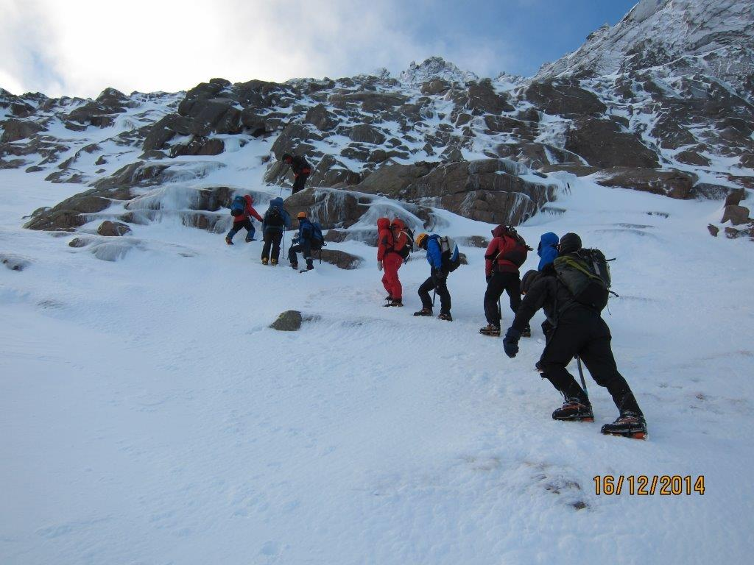
Winter conditions

Slide 10
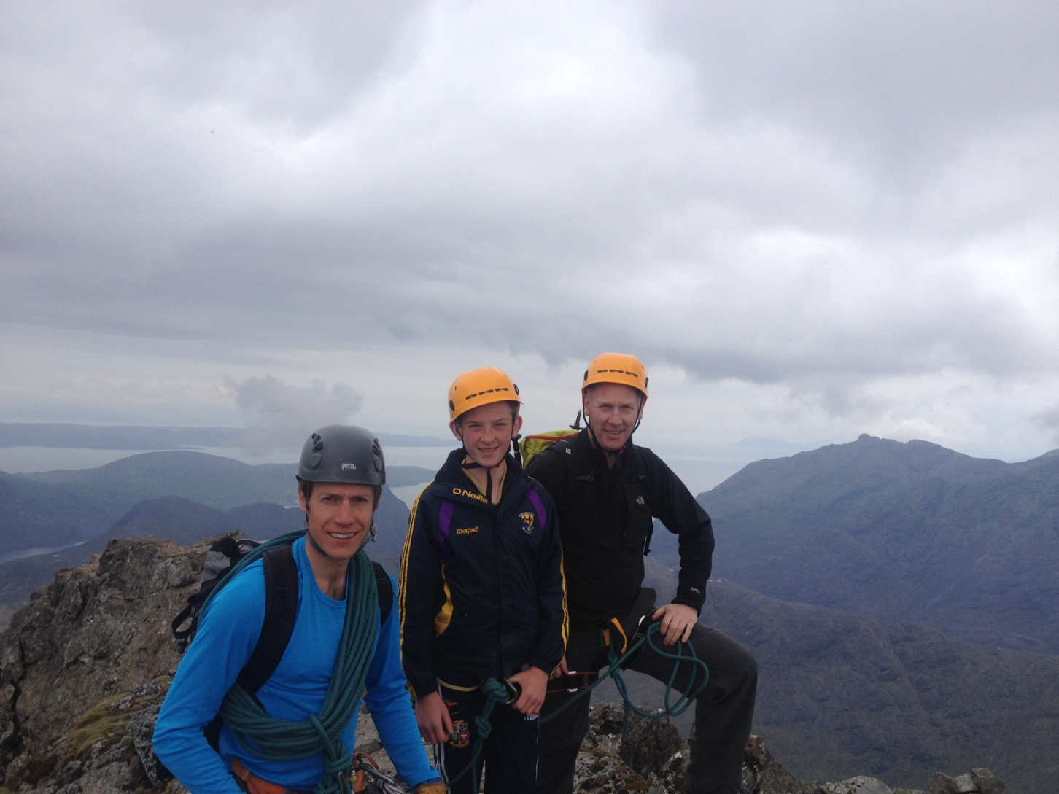
Pinnacle Ridge Skye

Slide 11
Current developments
NNAS online system designed by Tah dah
NNAS Bronze award SCQF accredited Level 4 2 credit points
Penetration with D of E, ACF, ATC, CCF Skillforce Outward Bound ISA
NNAS Tutors Award
Government interest in increasing access and removing barriers from participation is increasing emphasis on navigation as a life skill
We should all know where we are going... And getting off the path

Slide 12
NNAS Tutors Award
No recognisable methodology of teaching navigation within existing MTUK/ Joint services etc only BOF
Tutors Award written and supported by Glenmore Lodge (N Williams), NNAS(Me) British orienteering(D Riley)
A one day teaching navigation course for those who want to know how to teach it rather than learn how to do it.
No previous MTUK qualification needed.
Delivered by authorised NNAS Tutors

Slide 13
NNAS Bronze Award
Accreditation has lead to huge increase in numbers taking part (3000 more participants yr on yr this quarter)
Change in NNAS regulations around delivery of Bronze ratios of one Tutor to eight, working under one Provider
Flexibility of provision and delivery
Model allows for delivery of Bronze award to multiple participants

Slide 14
A suggested model..
Have a Tutors Award run for your school/ cluster group / or local network(maximum delivery 1:10). Group training cbe by NNAS
Have one person register as the Provider(responsible for H and S and risk management)
Program and deliver navigation instruction of Bronze within your organisation.
Optional moderation support of first Bronze award within organisation
Possibility of running awards for entire year groups with this method

Slide 15
Outline cost
X one day Tutor Course
for x ten: £500.00
X one Provider registration £75.00
X one hundred certificates
and badges for Bronze £500.00
Total £1075.00

Slide 16
Fridjof Nansen
“the future development of mankind depends on young people striking boldly out along new tracks. The great events of the world depend on the spirit of adventure shown by individuals grasping the opportunities when they occur”
We are investing in all our futures..

Slide 17
